Slide 1

Ansible AWX Installation on Kubernetes
Maithili Peetani
LinkedIn: https://www.linkedin.com/in/maithili-sharan-peetani-28349431/
https://github.com/sharanpeetani

Slide 2
What is Ansible Engine?
It’s an open-source automation tool used for configuration management,
application deployment, and provisioning
Ansible is simple, powerful, agentless
An Ansible playbook is a blueprint of automation tasks.
Its idempotent, agentless and easy to learn.

Slide 3

AWX is a web-based user interface, REST API, and task engine built on top of Ansible.

Slide 4
What does AWX stand for?
According to Michael DeHaan:
“It basically means Ansible Works. But nothing really.”
(it’s not an acronym)

Slide 5
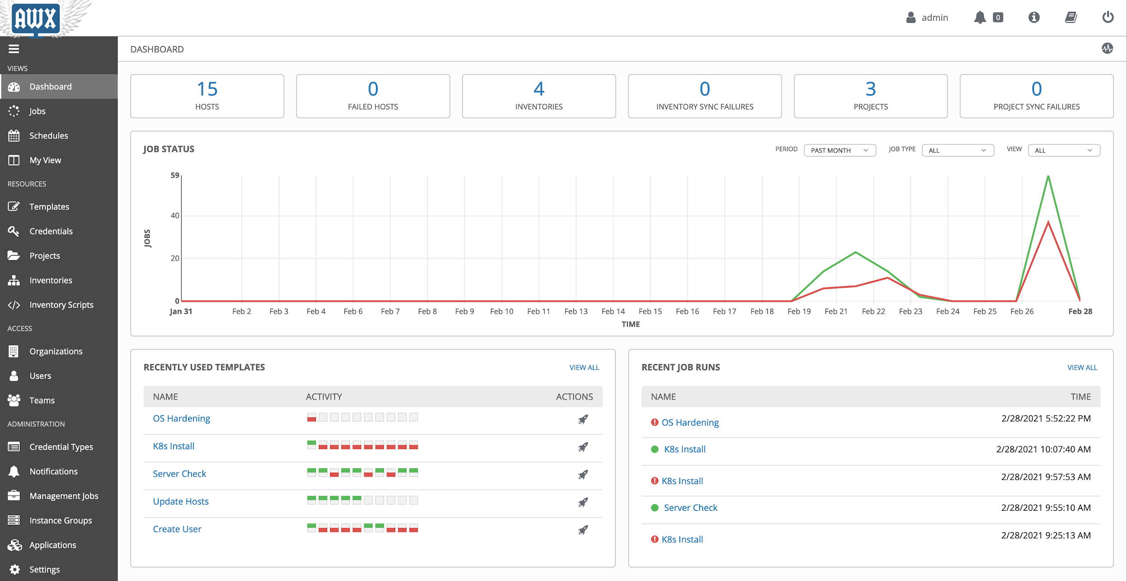
Why Ansible AWX
Ansible AWX is an opensource of Ansible Tower, so it’s free to use, GUI based, and RESTful API allowing you to scale IT automation, manage complex deployments and speed productivity.
✓ RBAC (Role-Based Access Control)
✓ Push Button – Easy to execute playbook
✓ RESTful API
✓ Workflow
✓ Enterprise Integrations
✓ Centralized Logging
✓ Ansible AWX is FREE

Slide 6
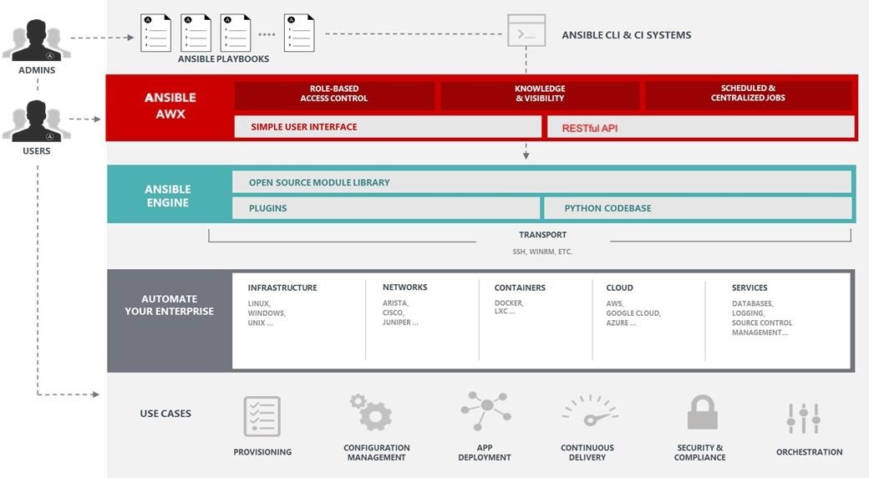
Ansible AWX Architecture

Slide 7
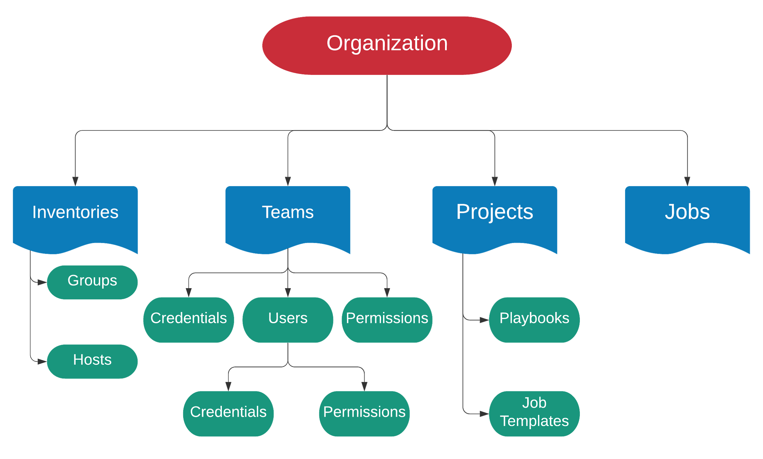

Slide 8
AWX is a community-based project sponsored by Red Hat.
https://www.ansible.com/products/awx-project/faq
http://github.com/ansible/awx

Slide 9
AWX lets you pull playbooks from a source code repository and run them against nodes using a nice neat GUI or API.
Source Code Repository
Playbooks
master
feature branch
ssh
ssh
Node
A P I
AWX
Node
Ansible
Node
Development branch
ssh

Slide 10
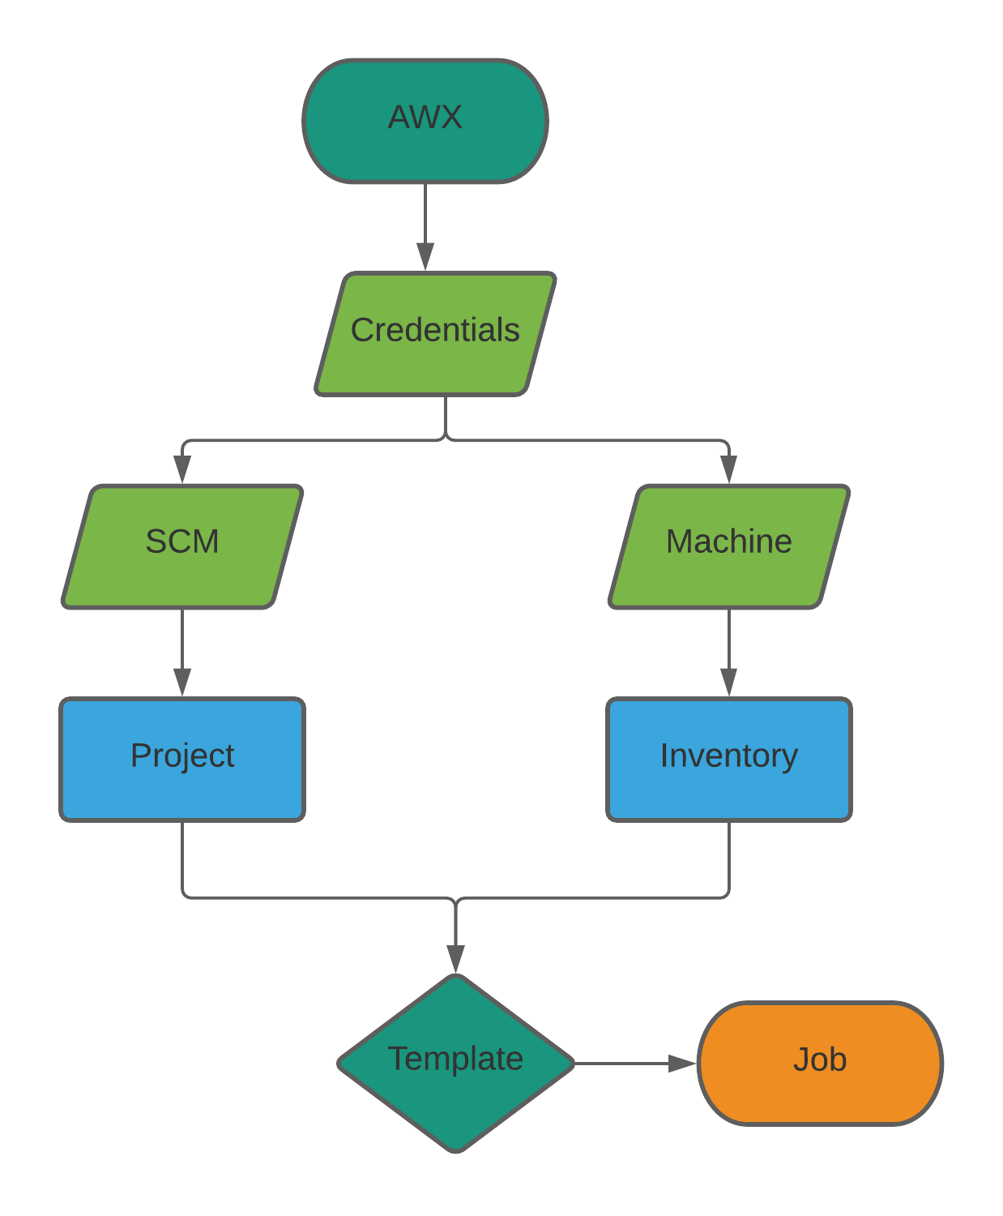
AWX Workflow

Slide 11
FEATURES
Real time playbook output
Push button deployment
Authentication
projects/jobs/workflows
Security
Notifications
Logging
Scheduling

Slide 12
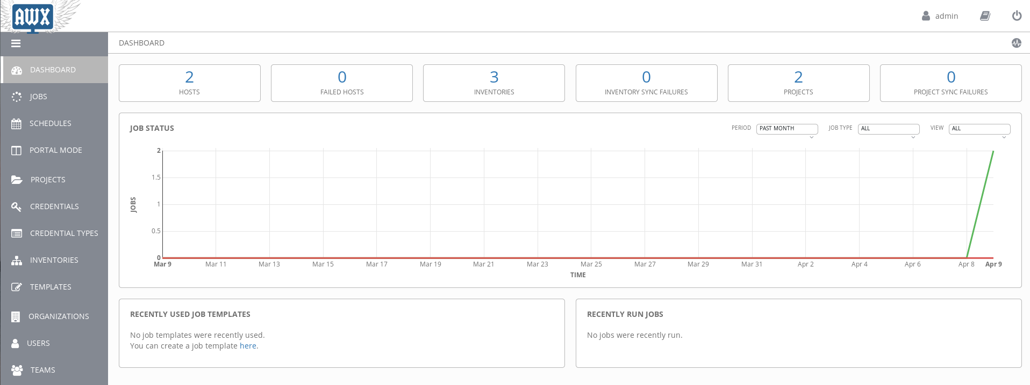
AWX Dashboard

Slide 13
AUTHENTICATION
Multiple authentication methods are available.
AWX Username / Password
Azure AD
Github
Google OAuth2
LDAP
RADIUS
SAML
TACACS+

Slide 14
SECURITY
Playbooks are executed in a CHROOT environment as the AWX user.
Full RBAC security model for every item within AWX.

Slide 15
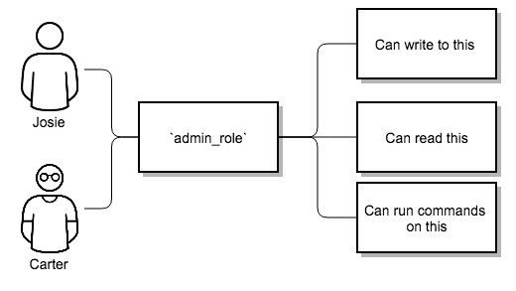
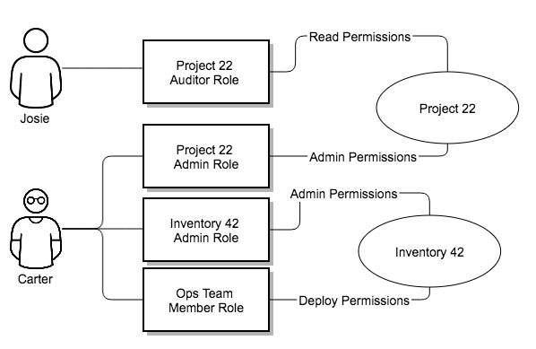
RBAC (Role-Based Access Control)

Slide 16
Inventories
Comparable to Ansible inventory files.
Can have multiple inventories.
Dynamic sync with GCP, AWS, Azure etc.
Write your own custom inventory scripts.

Slide 17
TEMPLATES / JOBS
Collection of playbooks (usually in SCM).
Template is the definition of a playbook (i.e. which playbook to use, credentials to use, variables etc).
A job is the output of a template run. Job output is saved so that you can review it later.
A workflow is a way to string together multiple playbooks.

Slide 18
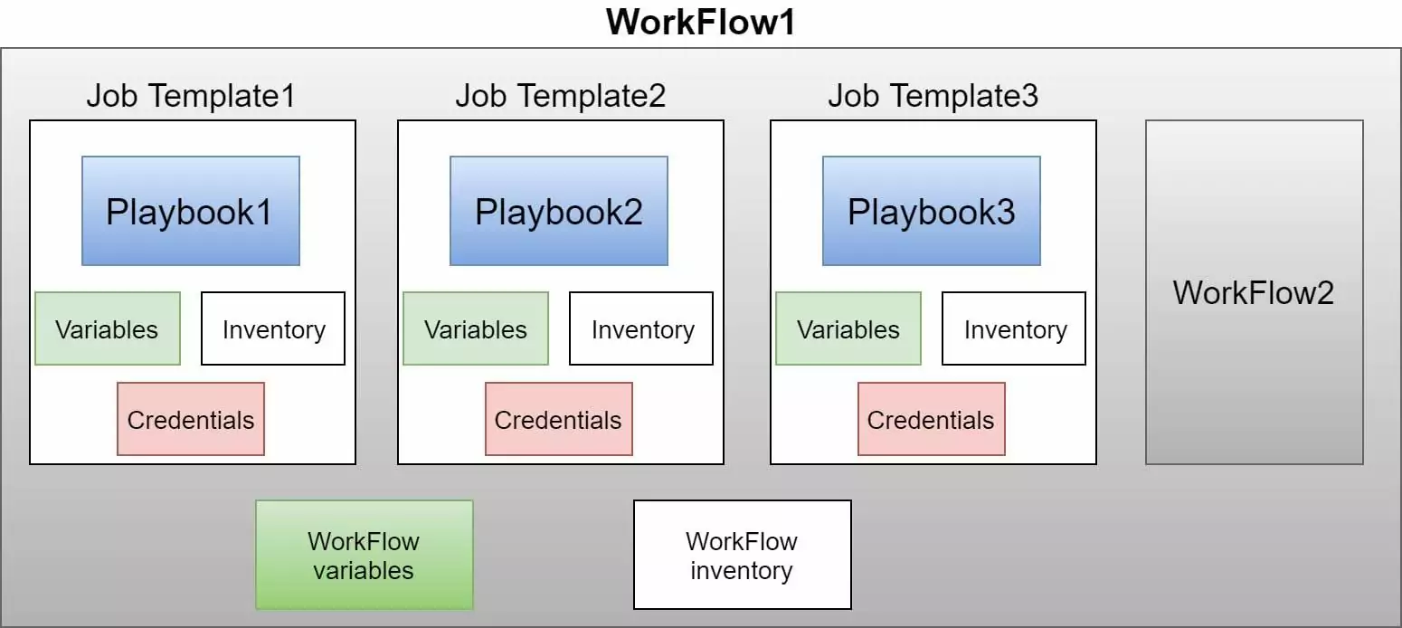
AWX Workflow Job

Slide 19
Supported Platforms
AWX by default installs on the following platforms:
Docker
Kubernetes
OpenShift

Slide 20
TIME FOR DEMO!!!

Slide 21
That's all folks!

